Slide 1

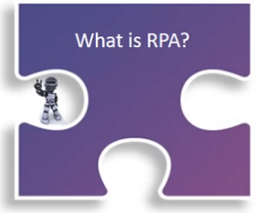
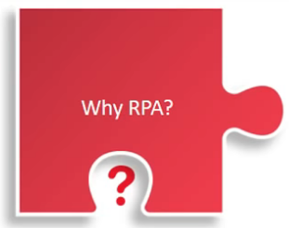

my paGE Dec 2017
Robotic Process Automation
- A path to the cognitive enterprise
What is RPA: RPA - Robotic Process Automation not just a new flavor of technology but a new approach to address voluminous, repetitive and rule based IT and Business processes – that previously required manual re-keying in applications, spreadsheets, and hard-copy documents.
Why RPA:
Robotic process automation or RPA has now become a trend for all types of businesses. RPA takes the robot out of the human. Processes are built by showing the robots what to do step by step rather than coding or scripting them, in exactly the same way as a human would use the end user systems. It can do repetitive stuff more quickly, accurately, and tirelessly than humans, freeing them to do other tasks requiring human strengths such as emotional intelligence, reasoning, judgment, and interaction with the customer.
How Different from Traditional Automation: There are several fundamental characteristics of RPA enabled solution that differ from Business Process Management (BPM) tooling and other traditional IT dependent solutions:
The RPA doesn’t fundamentally change the operation of the process. Instead of a human tapping the keys and building spreadsheets, a computer software application mimics the same tasks in a similar way.
Training of robots is generally performed using code-free software, so its quick to do and easy to adapt.
IT challenges like implementing complex APIs are removed by re-keying or robotically extracting/uploading data to legacy system.
Software Robots:
The ‘robot’ performs tasks exactly as a user does without needing to make any changes to the underlying systems. It’s as if the robot is sitting at the desk!
RPA software models the flow of work, training the robot to work with the various systems and to apply the required rules.
The robot has logins to existing systems and follows the same flow as a human. It even sends and receives emails.
RPA has both a strategic benefit as a sourcing option, and an obvious saving in processing cost. But the benefits have a much wider scope than cost alone.
RPA can be deployed as a smaller scope / tactical solution where it is hard to change the underlying systems.

Slide 2
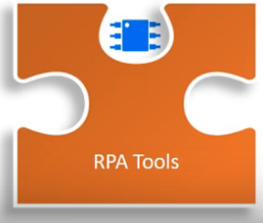
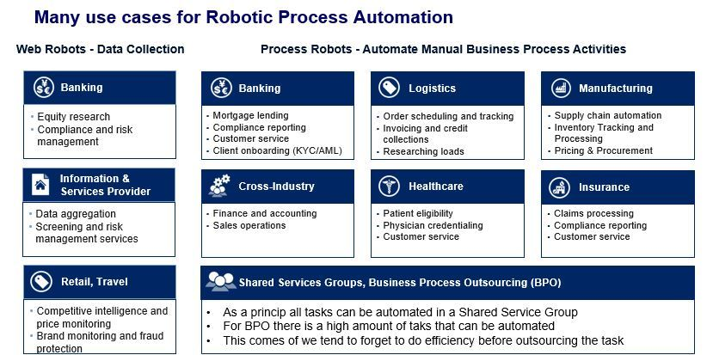
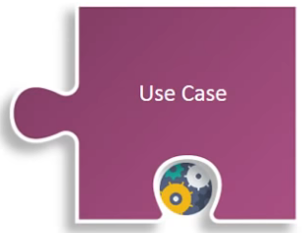
my paGE Dec 2017
Few Prominent Tools in RPA
UiPath:
They are one of the most leading RPA vendors in the industry.
Some of the UIPath components are:
UiPath Studio
Front Office and Back Office – UiPath Robots
UiPath Orchestrator
Blue Prism:
The term Robotic Process Automation was invented by Blue Prism, that itself proves they are the pioneers in Robotic Process Automation software development. Blue Prism has been recognized by the American IT research and advisory company Gartner, Inc.
Automation Anywhere:
Automation Anywhere is another top RPA vendors providing powerful and user-friendly robotic process automation tools to automate tasks of any complexity.
Robotic Process Automation can be used in many fields, below image would give us a brief idea of use cases for RPA.
Source: https://softwarerobotics.blog/2017/05/08/where-can-you-use-robotics-process-automation/

Slide 3
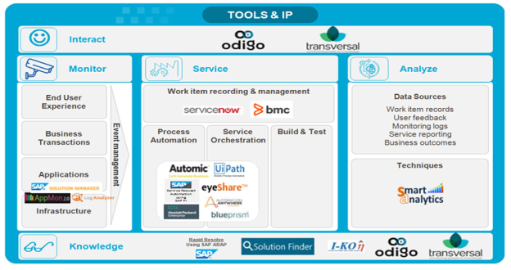
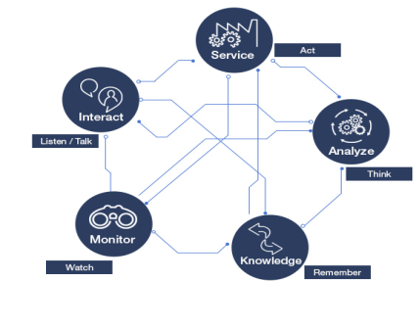
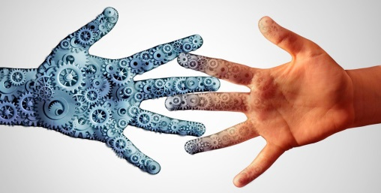
my paGE Dec 2017
Capgemini Approach towards Automation
Capgemini delivers artificial intelligence through integrated automation. Capgemini's automation approach is called Automation Drive Suite.
The Automation Drive Suite has a Framework, Tools & IPs and Services.
Automation Drive Framework that views Automation as the five senses -Listen/Talk, Watch, Act, Remember and Think
Automation Drive Tools & IPs that we use are:
Source: Automation Drive Academy
The approach is to work closely with our customers to understand the business and IT processes. And then map the processes to the five senses in our framework, fuse the processes with the best possible tools and create an automation solution.
RPA Can be a Great Buddy!
RPA was introduced specifically to automate routine and standardized tasks to free up employee bandwidth so that they could focus on the core business objectives.
Bots can automate routine tasks and eliminate inefficiency, but what about higher-order work requiring judgment and perception? Developers are incorporating cognitive technologies, including machine learning and speech recognition, into robotic process automation—and giving bots new power.
So let us welcome the robots to our technical world.
Self Nomination
Complete ICompass Assessments
Complete Training Module &Sessions
Apply For Certification
Where & How to start your Journey:

